Slide 1
Blindness
Inability to see
NO QUIZ ON 8TH APRIL. WE WILL HAVE MORE MARKS FOR EXAM OF SECTION III IN END SEM.

Slide 2
Causes of Blindness
Damage to:
Clear Structures in the eye, that allow the light to pass through
The nerves within the eye
Optic Nerve
Brain

Slide 3
Why we should be optimistic?
The Success of :
Cardiac pacemakers as neural prosthesis
Cochlear implants to restore hearing to the deaf
Rapid developments in :
VLSI design
Micro- fabrication technology

Slide 4
Overview
Biology of the Eye
MIT – Harvard Device
ASR – Artificial Silicon Retina
MARC – Multiple Unit Artificial Retina Chip Set System

Slide 5
BIONIC EYE ?
Bio-electronic eye
Electronic device which replaces functionality of a part or whole of the eye
Used for replacing functionality (or)
Adding functionality to the eye

Slide 6
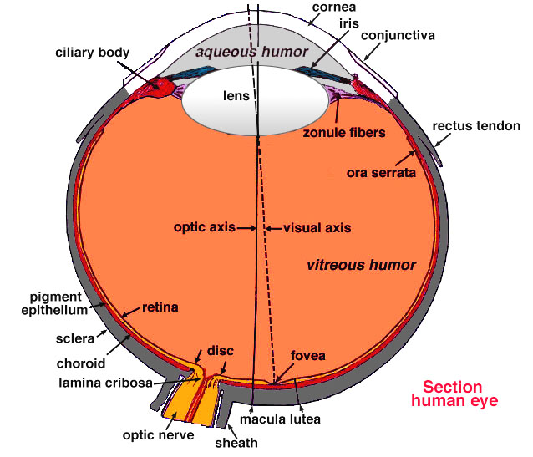
Structure of the Eye

Slide 7
Aqueous Humour
The aqueous humour is a jelly-like substance located in the anterior chamber of the eye.
Choroid
The choroid layer is located behind the retina and absorbs unused radiation.
Ciliary Muscle
The ciliary muscle is a ring-shaped muscle attached to the iris.
It is important because contraction and relaxation of the ciliary muscle controls the shape of the lens.
Cornea
The cornea is a strong clear bulge located at the front of the eye (where it replaces the sclera - that forms the outside surface of the rest of the eye).
The front surface of the adult cornea has a radius of approximately 8mm.
The cornea contributes to the image-forming process by refracting light entering the eye.
Fovea
The fovea is a small depression (approx. 1.5 mm in diameter) in the retina.
This is the part of the retina in which high-resolution vision of fine detail is possible.

Slide 8
Hyaloid
The hyaloid diaphragm divides the aqueous humour from the vitreous humour.
Iris
The iris is a diaphragm of variable size whose function is to adjust the size of the pupil to regulate the amount of light admitted into the eye.
The iris is the coloured part of the eye (illustrated in blue above but in nature may be any of many shades of blue, green, brown, hazel, or grey).
Lens
The lens of the eye is a flexible unit that consists of layers of tissue enclosed in a tough capsule. It is suspended from the ciliary muscles by the zonule fibers.
Optic Nerve
The optic nerve is the second cranial nerve and is responsible for vision.
Each nerve contains approx. one million fibres transmitting information from the rod and cone cells of the retina.
Papilla
The papilla is also known as the "blind spot" and is located at the position from which the optic nerve leaves the retina.
Pupil
The pupil is the aperture through which light - and hence the images we "see" and "perceive" - enters the eye. This is formed by the iris. As the size of the iris increases (or decreases) the size of the pupil decreases (or increases) correspondingly.

Slide 9
Retina
The retina may be described as the "screen" on which an image is formed by light that has passed into the eye via the cornea, aqueous humour, pupil, lens, then the hyaloid and finally the vitreous humour before reaching the retina.
The retina contains photosensitive elements (called rods and cones) that convert the light they detect into nerve impulses that are then sent onto the brain along the optic nerve.
Sclera
The sclera is a tough white sheath around the outside of the eye-ball.
This is the part of the eye that is referred to by the colloquial terms "white of the eye".
Visual Axis
A simple definition of the "visual axis" is "a straight line that passes through both the centre of the pupil and the centre of the fovea". However, there is also a stricter definition (in terms of nodal points) which is important for specialists in optics and related subjects.
Vitreous Humour
The vitreous humour (also known as the "vitreous body") is a jelly-like substance.
Zonules
The zonules (or "zonule fibers") attach the lens to the ciliary muscles.

Slide 10
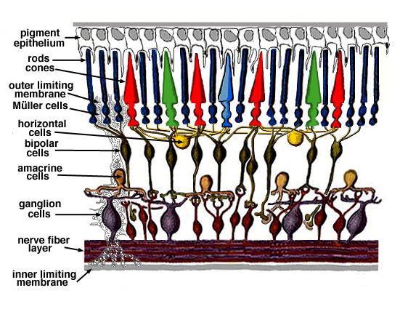
The Retina

Slide 11
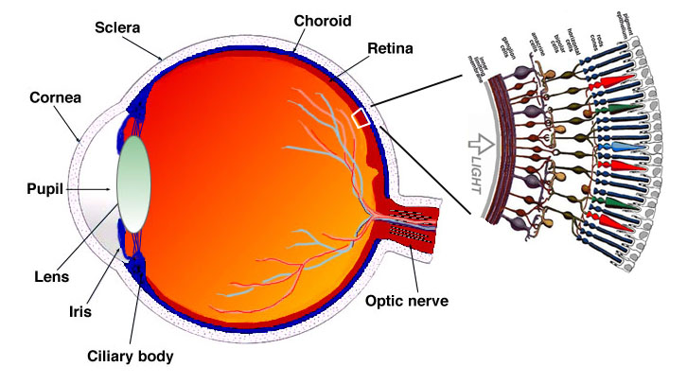
The Eye with Retina

Slide 12
A photoreceptor cell is a specialized type of neuron found in the retina that is capable of phototransduction. The great biological importance of photoreceptors is that they convert light (visible electromagnetic radiation) into signals that can stimulate biological processes. To be more specific, photoreceptor proteins in the cell absorb photons, triggering a change in the cell's membrane potential.
The two classic photoreceptor cells are rods and cones, each contributing information used by the visual system to form a representation of the visual world, sight. The rods are narrower than the cones and distributed differently across the retina, but the chemical process in each that supports phototransduction is similar.
There are major functional differences between the rods and cones. Rods are extremely sensitive, and can be triggered by as few as 6 photons.^{[3]} At very low light levels, visual experience is based solely on the rod signal. This explains why colors cannot be seen at low light levels: only one type of photoreceptor cell is active.
Cones require significantly brighter light (i.e., a larger numbers of photons) in order to produce a signal. In humans, there are three different types of cone cell, distinguished by their pattern of response to different wavelengths of light.
So, for example, an L cone cell contains a photoreceptor protein that more readily absorbs long wavelengths of light (i.e., more "red"). Light of a shorter wavelength can also produce the same response, but it must be much brighter to do so.
The human retina contains about 120 million rod cells and 6 million cone cells. The number and ratio of rods to cones varies among species, dependent on whether an animal is primarily diurnal or nocturnal. Certain owls, such as the tawny owl, have a tremendous number of rods in their retinae. In addition, there are about 2.4 million to 3 million ganglion cells in the human visual system, the axons of these cells form the 2 optic nerves, 1 to 2% of them photosensitive.

Slide 13
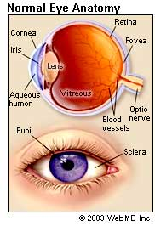
Healthy Vision
Reflected light enters the cornea (Window of the eye)
Light travels through the pupil
Contracts or dilates depending on how brightness of surroundings
Light enters the lens
Just like a camera, the lens of the eye focuses light
4. The light beams through the center of the eye to the retina
Retina:
Photoreceptors (Specialized cells that convert light into electric impulses)
Macula (Center of the retina that contains more photoreceptors than any other part of eye)

Slide 14
Diseases of the Eye
Retinitis Pigmentosa
Macular Degeneration

Slide 15
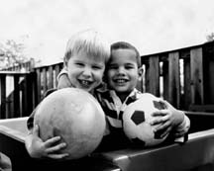
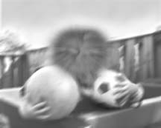
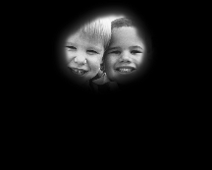
Reasons for Bionic Eye
Macular Degeneration
Retinitis Pigmentosa
Age Related
Loss of central vision and blurred peripheral vision
Macula deteriorates over time
Vision becomes gray
10% of adults over age 55 world-wide
Genetic
Loss of peripheral vision inward
Photoreceptors in periphery deteriorate
1.5 million people world-wide

Slide 16
Retinitis Pigmentosa
Hereditary Genetic Disease
Peripheral Rods degenerate
Gradually progresses towards center of eye
Spares the foveal region
Tunnel vision results

Slide 17
Macular Degeration
Genetically Related
Cones in Macula region degenrate
Loss or damage of central vision
Peripheral Retina spared
Common among old people

Slide 18
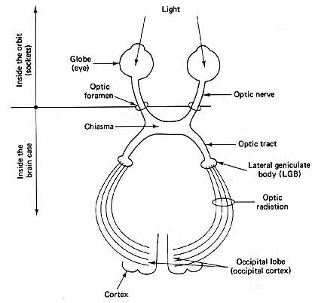
Regions of Implantation
Retina
Optic Nerve
Lateral geniculate body
Visual Cortex

Slide 19
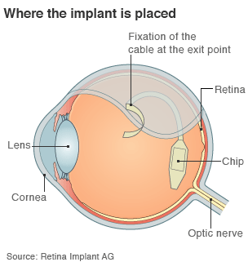
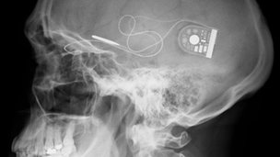
Retinal Implants
Notes:
Blind people have described smiles on friendly faces, the food on their plates, and household objects from telephones to dustbins, after surgeons fitted them with electronic chips to partially restore their vision.
Results from the first eight patients to enrole in a clinical trial of the retinal implants show that five found the chips improved their eyesight enough to be useful in everyday life.

Slide 20
MIT-Harvard device
Features
Epi-Retinal Approach
Microelectrode array replaces damaged photoreceptors
Power source – Laser(820nm wavelength)
Image Acquisition - Using CCD Camera
Patient spectacle holds the camera and power source

Slide 21
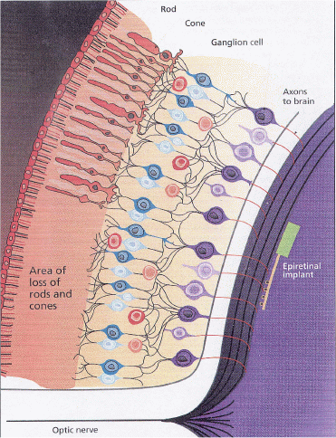
Site of Implant
Notes:
In anatomy, a ganglion (/ˈɡæŋɡliən/ GANG-glee-ən; plural ganglia) is a nerve cell cluster^{[1]} or a group of nerve cell bodies located in the peripheral nervous system.^{[2][3]} Cells found in a ganglion are called ganglion cells, though this term is also sometimes used to refer specifically to retinal ganglion cells.

Slide 22
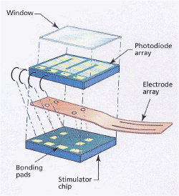
Implant Structure
Layers
1- Photodiode Array
2- Polyimide strip
3- Stimulator chip
Electrodes on other end of Polyimide strip

Slide 23
Working of the System - 1
CCD camera input – External light intensity
CCD output amplitude-modulates laser source
This hits photodiode array of implant
This in turn powers stimulator chip (SC)

Slide 24
Working of the System - 2
SC drives current to electrodes facing retina
This excites the ganglionic cells > axons > optic nerve > visual cortex in occipital lobe of brain
Brain helps in perceiving an image

Slide 25
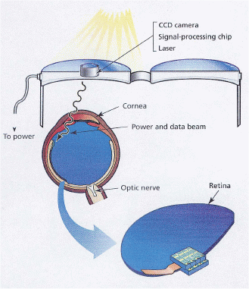
The Whole Picture

Slide 26
Advantages
Very Early in the visual pathway
No Batteries implanted within body
No complicated surgical procedure
Power Requirement – ¼ of milliwatt

Slide 27
Disadvantages
Axons b/w electrodes and ganglionic cells
Other axons get excited – unwanted perception of large blur
Extra circuitry required for downstream electrical input

Slide 28
Artificial Retina Prosthesis using ASR (Artificial Silicon Retina)

Slide 29
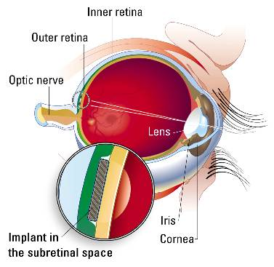
The Eye
Human Eye is similar to a camera
Macula provides the highest
resolution of the image which
we see.
Macula is comprised of multiple
layers of cells which process
the initial “analog”light energy
entering the eye into “digital”
electrochemical impulses.
Human eye has nearly
100 million photoreceptors.

Slide 30
Need for ASR
Retinitis Pigmentosa(RP) and Age related Macular degeneration (ARMD)
are Progressive blinding disorders of the outer retina which involve degeneration of the neurons.
There are no proven effective therapeutic remedy for these disorders .
Some of Methods employed to slow or halt the disease time course are
Use of Intravitreal injection of certain growth factors.
Identification of specific gene mutations has led to the development of the gene therapy approaches.
Transplantation can be effective in rescuing the photoreceptors
from degeneration.

Slide 31
Need for ASR
The first two methods are promising for treating patients early in the course of the degenerative process, they are of relatively modest value for the patients in whom the photoreceptors have already degenerated.
Besides the Genetic and the Anatomic approach , there is an need to find an alternative approach.

Slide 32
Fundamental idea behind ASR
ASR is a solid state biocompatible chip which contains an array of photo receptors ,and is implanted to replace the functionality of the defective photoreceptors .
Current generated by the device in response to light stimulation will alter the membrane potential of the overlying neurons and thereby activate the visual system.
Visual sensations or “phosphenes” can be evoked by electrical stimulation of the different levels of the visual pathway.
Phosphenes are evoked by the stimulation of the eyeball or the visual cortex.
Artificial vision created by the controlled electric stimulation of the retina has color.
Notes:
A phosphene is a phenomenon characterized by the experience of seeing light without light actually entering the eye. The word phosphene comes from the Greek words phos (light) and phainein (to show). Phosphenes that are induced by movement or sound are often associated with optic neuritis.

Slide 33
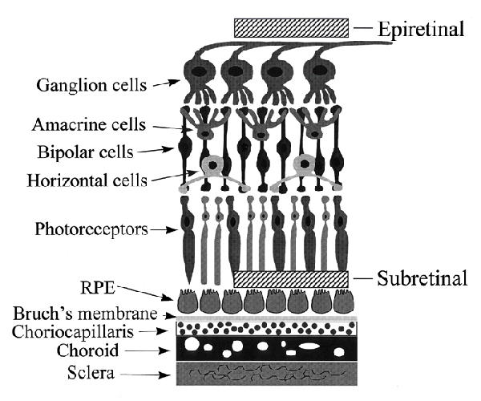
Approaches Towards Retinal Prosthetic Implantation
Epiretinal Approach involves a
semiconductor based device positioned
on the surface of the retina to try to simulate
the remaining overlying cells of the retina.
Subretinal Approach involves
implanting the ASR chip behind the
retina to simulate the remaining
viable cells.

Slide 34
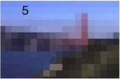
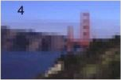
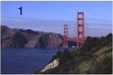
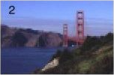
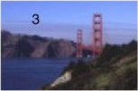
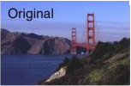
Enhancement of the image quality using the ASR

Slide 35
Limitations Of ASR’s
ASR is designed to interface and function with the retina that has partial outer retinal degeneration.
ASR can be applied only when the photoreceptor cellular layer of the retina is damaged but the remaining cellular layers are still functional.
ASR can be effectively applied to RP and AMD.
Conditions amenable to treatment with ASR’s include some forms of long-term retinal detachment,Usher’s syndrome, Cone- Rod Dystrophy.
Notes:
Usher syndrome is a relatively rare genetic disorder caused by a mutation in any one of 10 genes resulting in a combination of hearing loss and visual impairment, and is a leading cause of deafblindness. Usher syndrome is incurable at present.

Slide 36
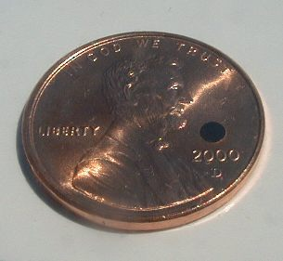
Sub-Retinal Approach
The basic idea-”Alter the membrane potential”
IMPLANT DESIGN
Primitive devices
Single photosensitive pixel(3mm in diameter)
Neo devices
The current micro photodiode array (MPA) is comprised of a regular array of individual photodiode subunits, each approximately 20×20-µm square and separated by 10-µm channel stops. The resulting micro photodiode density is approximately 1,100/m².

Slide 37
IMPLANT features
The size has decreased from 250um to 50um
No external power supply
500nm to 1100nm wavelength response

Slide 38
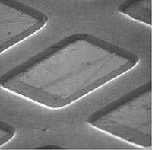
Micro photodiodes

Slide 39
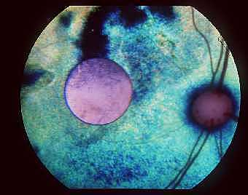
ASR implanted into the eye

Slide 40
BIO-COMPATIBILTY results
The good news
There is no progressive change in retinal appearance that may be associated with retinal toxicity.
The Bad news
Loss of photoreceptive layer over the region of implant which is expected due to deprival of oxygen and nutrients to those cells underlying the chip.

Slide 41
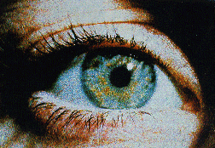
Multiple Unit Artificial Retina Chipset
(MARC)

Slide 42
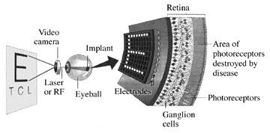
Conceptual Design

Slide 43
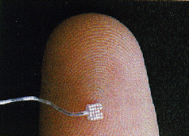
Platinum on Silicone Rubber Electrode Array

Slide 44
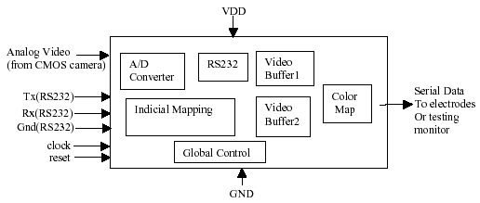
Block diagram of Image Acquisition System

Slide 45
Advantages of MARC system
Compact Size – 6x6 mm
Diagnostic Capability
Reduction of stress upon retina

Slide 46
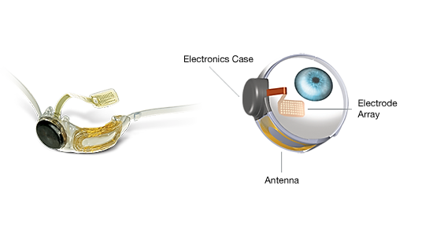
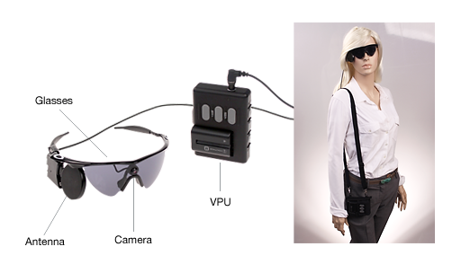
Components (The Argus®II)
Internal Parts
External Parts

Slide 47
Eligibility, Procedure, and Cost
Must have Retinitis Pigmentosa *Newer models will work with Macular Degeneration
Showing later symptoms of disease
2 to 5 hour surgical procedure for internal parts
Small incision, minimal scarring, and uncomplicated
Return to hospital for external fitting and programming
Training and therapy
Patients must learn to recognize objects with bionic eye
$115,000 in Europe before surgery
$150,000 in U.S.A. before surgery
Insurance companies will help more as the technology improves

Slide 48
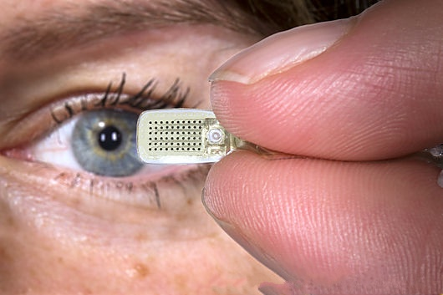
Benefits & Future Outlook
Partial restoration of vision
Gain more independence
Able to view objects on a larger scale
Upgradable software
If newer technology is released further surgery is unnecessary
Argus®I (Prototype)
16 pixels of resolution
15 seconds to recognize an object
Argus®II (On the Market)
60 pixels of resolution
2 to 3 seconds to recognize an object
Argus®III (In Progress)
200 pixels of resolution
Recognition time unavailable

Slide 49
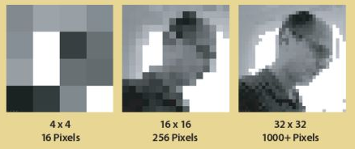
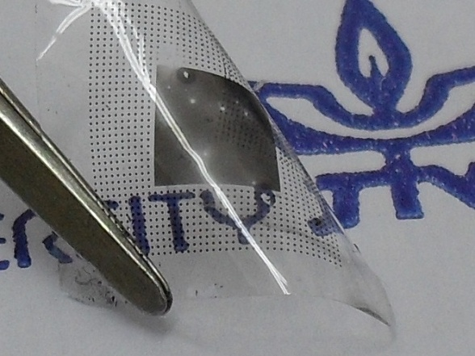
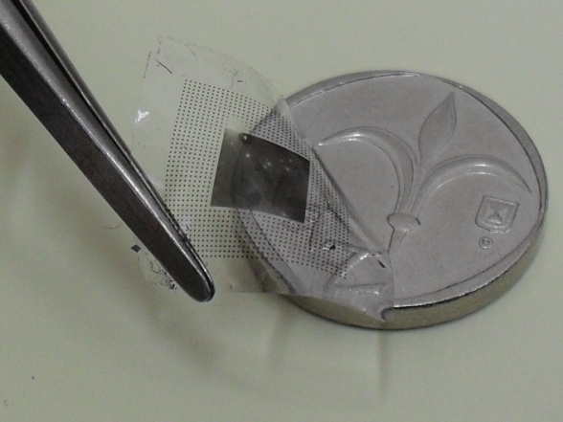
The future

Slide 50
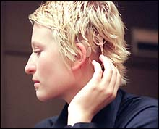
What is a Cochlear Implant?
-A biomedical device that presents an auditory signal using electrical stimulation of the inner ear.
Source: seattlepi.nwsource.com/ lifestyle/echo28.shtml

Slide 51
Cochlear Implants
The cochlear implant is the most significant technical advance in the treatment of hearing impairment since the development of the hearing aid around the turn of the century.
Designed to restore some sense of hearing for:
Children or adults who receive little or no benefit from hearing aids.
Loss must be: (a) profound, (b) bilateral, and (c) sensorineural.
Problem: Auditory nerve is intact, but hair cell transducers are not functioning.
Purpose of implant: Generate electrical signals that do the job of the damaged hair cells.

Slide 52
The ear has external, middle, and inner portions. The outer ear is called the pinna and is made of ridged cartilage covered by skin. Sound funnels through the pinna into the external auditory canal, a short tube that ends at the eardrum (tympanic membrane).
The middle ear is an air-filled cavity behind the tympanic membrane, includes three bones: the malleus (or hammer), incus (or anvil), and stapes (or stirrup). The middle ear also connects to the upper throat via the Eustachian tube
Sound causes the eardrum and its tiny attached bones in the middle portion of the ear to vibrate, and the vibrations are conducted to the nearby cochlea. The spiral-shaped cochlea is part of the inner ear; it transforms sound into nerve impulses that travel to the brain.
The fluid-filled semicircular canals (labyrinth) attach to the cochlea and nerves in the inner ear. They send information on balance and head position to the brain. The eustachian (auditory) tube drains fluid from the middle ear into the throat (pharynx) behind the nose

Slide 53
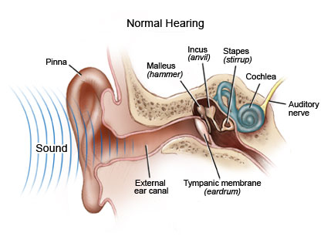
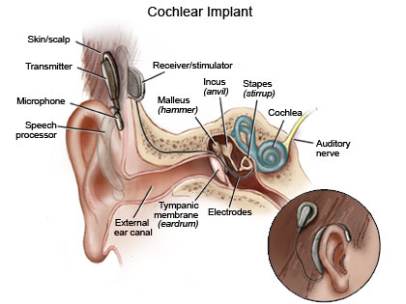
Cochlear implants

Slide 54
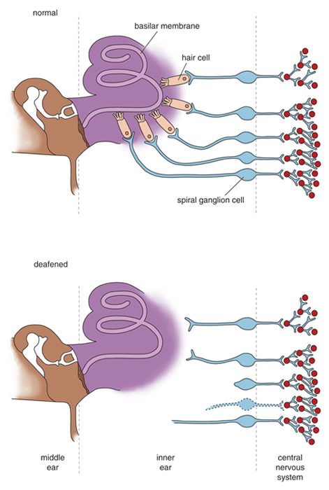
Normal Ear
Deafness: Normally functioning hair cells not present; some atrophy of neural fibers.

Slide 55
Historical Background
Late 1790’s
-Alessandro Volta performed an experiment which directly stimulated his own auditory nerve using direct current.
-He described hearing “a kind of crackling or bubbling.”

Slide 56
Historical Background cont...
1868
-Brenner stimulated the ear using alternating current. He varied the polarity, intensity, and rate of the stimulus.
-Subjects reported hearing “…strange metallic-like sounds…”

Slide 57
A Brief Historical Background cont...
Jump to the 1950’s and 1960’s…
-Experiments performed that directly electrically stimulated the human cochlear by implanting electrodes in the middle or inner ear.
-Some hearing percepts were reported, although these early experimental devices allowed virtually no speech recognition.

Slide 58
Historical Background cont...
The 1960’s to the 1970’s: Lots of questions such as...
How should auditory information (frequency and intensity) be coded in an implant device?
It was known that profoundly deaf people lose auditory nerve cells (spiral ganglion cells). Would this mean an implant wouldn’t work if there was nothing to stimulate?
If there were enough spiral ganglion cells to stimulate in a profoundly deaf person, would the implant physically destroy the remaining cells?

Slide 59
How Does A Cochlear Implant Work?
The implant is surgically placed under the skin behind the ear. The basic parts of the device include:
External:
one or more microphones which picks up sound from the environment
a speech processor which selectively filters sound to prioritize audible speech, splits the sound into channels and sends the electrical sound signals through a thin cable to the transmitter,
a transmitter, which is a coil held in position by a magnet placed behind the external ear, and transmits power and the processed sound signals across the skin to the internal device by electromagnetic induction,
Internal:
The internal part of a cochlear implant (model Cochlear Freedom 24 RE)
a receiver and stimulator secured in bone beneath the skin, which converts the signals into electric impulses and sends them through an internal cable to electrodes,
an array of up to 22 electrodes wound through the cochlea, which send the impulses to the nerves in the scala tympani and then directly to the brain through the auditory nerve system. There are 4 manufacturers for cochlear implants, and each one produces a different implant with a different number of electrodes. The number of channels is not a primary factor upon which a manufacturer is chosen; the signal processing algorithm is also another important block.

Slide 60
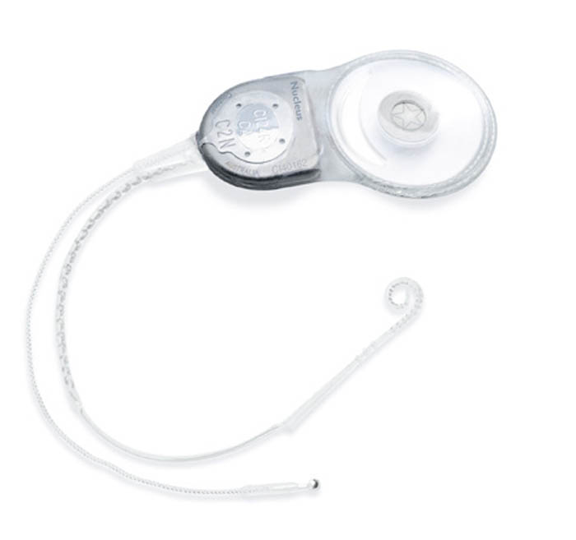
How Does a Cochlear Implant Work?
Electrical pulses are sent to the metal bands on the electrode array
Precisely controlled current flows between the active electrode(s) and return electrode(s)
→ Spiral ganglion cells are stimulated
Source: www.cochlear.com

Slide 61
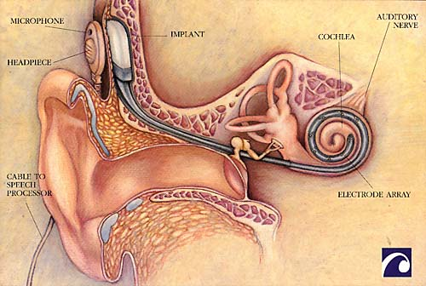
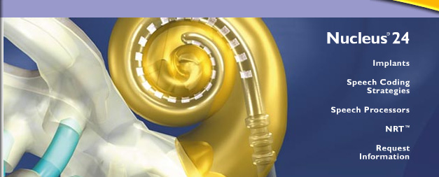

Slide 62
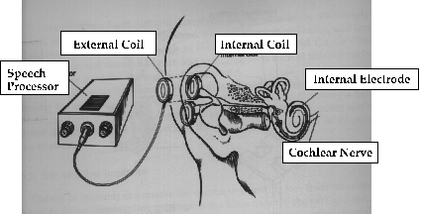
The speech processor uses a bank of bandpass filters (or a Fourier analyzer) to analyze the signal before passing it along to the array of electrodes.

Slide 63
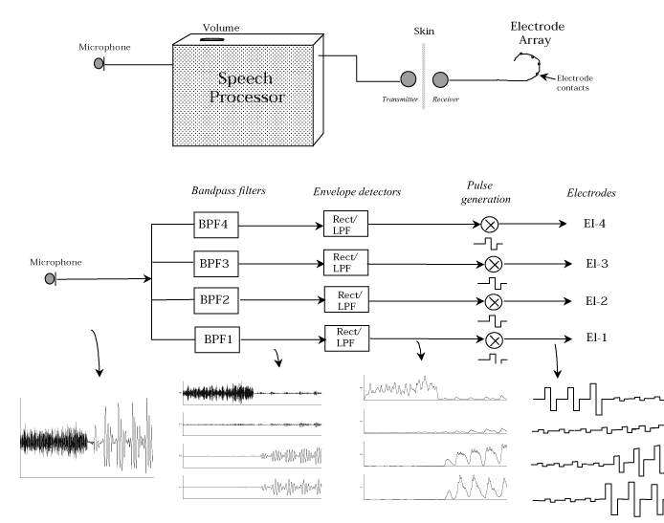

Slide 64
GOOD NEWS, BAD NEWS
First the Bad News
Implant based primarily on place theory. If we make the most generous assumption that place theory is correct (it probably isn’t), how many stimulating electrodes should there be?
The CI restores some sense of hearing, but it is nowhere near the hearing sensation that is produced in a normal ear. (There are no “bionic parts” that work as well as the original.)
Subjects vary wildly in the amount of benefit they derive from a CI -- mostly for unknown reasons.

Slide 65
Now the Good News
Despite these drawbacks, CIs work. Research shows:
Ability to understand speech improves.
Children acquire speech and language skills more quickly.
Post-lingually deafened adults (the largest deaf population) maintain their speech production skills better -- especially control of pitch and loudness, which improves immediately most of the time.

Slide 66
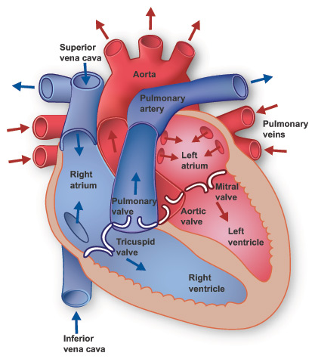
The human heart
The heart pumps blood through both circulatory systems. Blood low in oxygen from the systemic circulation enters the right atrium from the superior and inferior vena cavae and passes to the right ventricle. From here it is pumped into the pulmonary circulation, through the lungs where it receives oxygen and gives off carbon dioxide. Oxygenated blood then returns to the left atrium, passes through the left ventricle and is pumped out through the aorta to the systemic circulation−where the oxygen is used and metabolized to carbon dioxide. In addition the blood carries nutrients from the liver and gastrointestinal tract to various organs of the body, while transporting waste to the liver and kidneys. Normally with each heartbeat, the right ventricle pumps the same amount of blood into the lungs as the left ventricle pumps out into the body. Veins transport blood to the heart, while arteries transport blood away from the heart. Veins normally have lower pressures than arteries.

Slide 67
Some Numbers
Normal Heart Rate : 72 beats per minute
Per day : 1,03,680 … almost 1 lakh
Per year : 3,78,43,200 … about 3.75 Crores
Over a lifetime : 245 Crores (in about 65 years).
Volume Pumped per Beat : about 70ml (Stroke Volume)
Per minute : 5040 ml (approximately total blood volume in body)
Per day : 7260 litres (daily per capita requirement of water in India 135 l)
Per year : 26.6 lakh litres
In a life time : 17 Crore litres

Slide 68
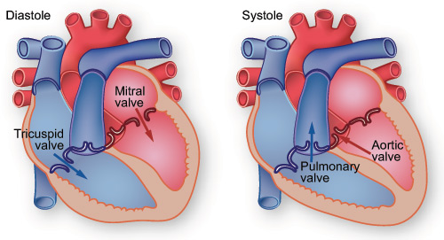
Heart Beat and Valves

Slide 69
Heart Valves
Four valves regulate blood flow through your heart: The tricuspid valve regulates blood flow between the right atrium and right ventricle.
The pulmonary valve controls blood flow from the right ventricle into the pulmonary arteries, which carry blood to your lungs to pick up oxygen.
The mitral valve lets oxygen-rich blood from your lungs pass from the left atrium into the left ventricle.
The aortic valve opens the way for oxygen-rich blood to pass from the left ventricle into the aorta, your body's largest artery.

Slide 70
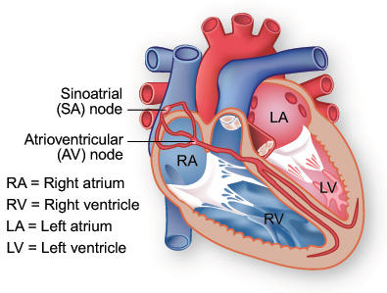
Heart Conduction Pathway

Slide 71
Electrical impulses from your heart muscle (the myocardium) cause your heart to beat (contract). This electrical signal begins in the sinoatrial (SA) node, located at the top of the right atrium. The SA node is sometimes called the heart's "natural pacemaker." When an electrical impulse is released from this natural pacemaker, it causes the atria to contract. The signal then passes through the atrioventricular (AV) node. The AV node checks the signal and sends it through the muscle fibers of the ventricles, causing them to contract.
The SA node sends electrical impulses at a certain rate, but your heart rate may still change depending on physical demands, stress, or hormonal factors.

Slide 72
Heart Beat
A heartbeat is a two-part pumping action that takes about a second. As blood collects in the upper chambers (the right and left atria), the heart's natural pacemaker (the SA node) sends out an electrical signal that causes the atria to contract. This contraction pushes blood through the tricuspid and mitral valves into the resting lower chambers (the right and left ventricles). This part of the two-part pumping phase (the longer of the two) is called diastole.
The second part of the pumping phase begins when the ventricles are full of blood. The electrical signals from the SA node travel along a pathway of cells to the ventricles, causing them to contract. This is called systole.

Slide 73
Heart Beat
As the tricuspid and mitral valves shut tight to prevent a back flow of blood, the pulmonary and aortic valves are pushed open. While blood is pushed from the right ventricle into the lungs to pick up oxygen, oxygen-rich blood flows from the left ventricle to the heart and other parts of the body.
After blood moves into the pulmonary artery and the aorta, the ventricles relax, and the pulmonary and aortic valves close. The lower pressure in the ventricles causes the tricuspid and mitral valves to open, and the cycle begins again. This series of contractions is repeated over and over again, increasing during times of exertion and decreasing while you are at rest. The heart normally beats about 60 to 80 times a minute when you are at rest, but this can vary. As you get older, your resting heart rate rises. Also, it is usually lower in people who are physically fit.

Slide 74
Valve Disorders
Valve disorders can be categorized into the following types:
Stenosis (narrowing) Sometimes age or disease can prevent heart valves from opening properly. The narrowing of heart valves is known as stenosis. When the opening narrows, the heart cannot push the required amount of blood through the valve. Because stenosis makes the heart work harder to pump the same volume of blood, it may also lead to an increase in the size of the heart muscle. Enlargement of the heart muscle may lead to serious complications.
Pulmonary valve stenosis Pulmonary valve stenosis is a narrowing or obstruction that partly or completely blocks the flow of blood. Obstructions can occur in heart valves, arteries or veins. This condition results in the narrowing of the pulmonary valve (which lets blood flow from the right lower chamber of the heart to the lungs). As a result, the right lower chamber (right ventricle) must pump harder than normal to overcome the obstruction. This may cause stress on, and enlargement of, the right ventricle.

Slide 75
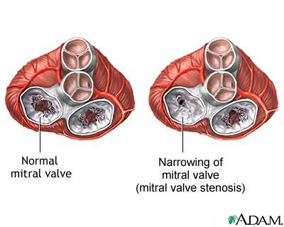
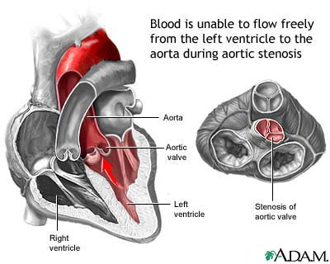
Valve problems
Mitral stenosis
Aortic stenosis
Stenosis is the obstruction or narrowing of valve opening
More pressure on atria and ventricles (respectively) to deliver sufficient blood
health.allrefer.com
health.allrefer.com

Slide 76
Valve Disorders
Prolapse (slipping out of place) In valve prolapse, the valve flaps do not close smoothly or evenly. Instead, they collapse backwards into the heart chamber they are supposed to be sealing off. This sometimes makes a clicking noise and allows a small amount of blood to leak backward through the valve. This group of conditions may be called mitral valve prolapse, click-murmur syndrome, Barlow's syndrome, balloon mitral valve and floppy valve syndrome.
Regurgitation (backward flow) Another common problem occurs when a heart valve doesn't close securely. This is called regurgitation (or sometimes called valvular insufficiency). This condition reduces the heart's pumping efficiency. When the heart contracts, blood is pumped forward in the proper direction and is also forced backwards through the damaged valve. This not only limits the heart's ability to supply the body with blood, but may also cause lung problems.

Slide 77
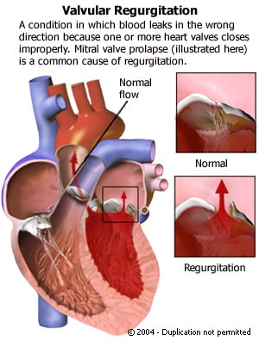
Valve problems
Mitral insufficiency
Atrial insufficiency
Inability of the valve
to close completely
http://www.heartcenteronline.com/myheartdr/common/articles.cfm?ARTID=187

Slide 78
Valve replacement
Various types of valves used falls under ‘biomaterials and prosthetics’
Valve replacement involves
Incision of chest wall, hence disrupting vacuum system in the thoracic cavity essential for breathing
Disrupting the function of heart itself hence the supply of blood to capillaries
Various accessories needed during the surgery
Extra corporeal circulation or heart lung bypass machine
Pump that replaces heart
Oxygenator that replaces lungs

Slide 79
What is it?
An artificial heart valve is a mechanism that mimics the function of a human heart valve
It’s used for patients with a heart valvular disease or have a damaged valve
Heart valves are used to provide the heart with a unidirectional blood flow
They act as pumps
Notes:
There are 4 valves in the heart: aortic, mitral, pulmonary, and tricuspid valve
79

Slide 80
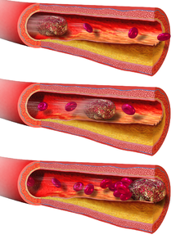
“An ideal Prosthetic valve”
Unidirectional flow
Durable : 40million cycles/year
Blood compatible: no thrombus, embolus
An embolus is any detached, traveling intravascular mass carried by circulation, which is capable of clogging arterial capillary beds (create an arterial occlusion) at a site distant from its point of origin.
Central flow: Laminar not turbulent
Closing not damaging blood cells
Last but not the least important – It should be quiet

Slide 81

Evolution of Prosthetic Heart Valves
The development of the original ball-and-cage valve design can be attributed to the bottle stopper in 1858
In the early 1950’s, it led to the idea of a prosthetic heart valve consisting of a cage with a mobile spherical poppet
First implanted in a human in a closed procedure in September of 1952. In 1953, marked successful use of the heart and lung machine, paving the way for the 1st open heart operations

Slide 82



Types of Artificial Heart Valves
Mechanical- There are three types. The caged ball, tilting disk, and bileaflet
Tissue(biological)- valves that are used from animals to implant them back into humans
Notes:
82

Slide 83

Mechanical Heart Valves
All the types of mechanical heart valves are still in use today.
Usually made of titanium or carbon which makes them strong and very durable
Three types of mechanical heart valves
Notes:
An accelerated test for mechanical heart valves actually suggested that it could last for 50,000 year. Most of the heart valves in the bottom right picture have been discontinued and replaced with new models
Ball and cage: The ball pushes against the cage when the pressure of the hearts chamber exceeds the pressure outside, letting blood flow. Pressure drops when heart contracts and makes a seal
Tilting disk: single disc controlled by a metal strut, opens and closes when blood is pumped through.
Bileaflet: two semi circular leaflets rotate around a housing. Has more natural bloodflow than the other mechanical heart valves
83

Slide 84


Tissue Heart Valves (biological valves)
Using valves from other animals. The porcine valve of a pig is the most comparable valve to a human.
Xenotransplantation
Xenotransplantation, is the transplantation of living cells, tissues or organs from one species to another. Such cells, tissues or organs are called xenografts or xenotransplants. In contrast, the term allotransplantation refers to a same-species transplant. Human xenotransplantation offers a potential treatment for end-stage organ failure, a significant health problem in parts of the industrialized world. A continuing concern is that many animals, such as pigs, have a shorter lifespan than humans, meaning that their tissues age at a quicker rate.
Pericardial valves:The pericardial heart valve was invented by Marian Ionescu, a British surgeon working at the General Infirmary in Leeds, England. He created this artificial bioprosthetic heart valve as a three-cusp structure made of chemically treated bovine pericardium attached to a Dacron cloth-covered titanium frame.
Notes:
Most of the united states and Europe use the tissue valves. Procine valves have been used in replacement surgery for over 20 years.
84

Slide 85
Bileaflet valves
Two semicircular leaflets that rotate about struts attached to the valve housing
Good hemodynamic performance - improved flow characteristics, lower transvalvular pressure gradients, less blood flow turbulence, improved hemodynamics at a given annular diameter, a larger orifice area and low bulk and flat profile
the least thrombogenic of the artificial valves
most commonly implanted mechanical valves

Slide 86

Advantages
Mechanical heart valves: The biggest advantage is the durability. While the tissue heart valves are estimated to last about 10-15 years, a mechanical heart valve can last 30 year
Tissue heart valves: There is minimal blood regurgitation, minimal transvalvular pressure gradient, self repairing.
Does not require and anti-coagulant drug.
Notes:
Provides optical blood flow
86

Slide 87

Disadvantages
Mechanical heart valves – In order to decrease the risk of blood clotting, the patient must take blood thinners. Some patients can hear their mechanical heart valve open and close.
Tissue heart valves – Wear, there is a small possibility that the body will reject the valve, inability to implant
them into infants and
children.
Notes:
Mechanical disadvantage- is cavitation, when the rapid change in pressure drop will form vaporous micro bubbles. This will cause blood cell damage.
87

Slide 88

Implanting
Both mechanical and tissue heart valves require open heart surgery
It’s more common in tissue valves for a re-operation
Complete recovery from surgery could be a couple of weeks to several months
Currently: 55% mechanical valves
45% tissue valves
Notes:
Risk of surgery: death, heart attack, irregular heart beat, kidney failure, stroke, infection
88

Slide 89

FDA-approved prosthetic heart valves

Slide 90

Haemodynamics of blood flow
Profile and hemodynamics of each main valve type. A. Whereas ball and cage valves are associated with a lack of central blood ejection fraction, tilting disc valves are associated with turbulent blood flow at the lesser orifice. B. Bileaflet valves have the lowest profile compared with ball and cage valves and tilting disc valves – better transvalvular gradient. However prone to backflow
Notes:
Profile and hemodynamics of each main valve type. A. Whereas ball and cage valves are associated with a lack of central blood ejection fraction, tilting disc valves are associated with turbulent blood flow at the lesser orifice. B. Bileaflet valves have the lowest profile compared with ball and cage valves and tilting disc valves – better transvalvular gradient. However prone to backflow

Slide 91
However, inspite of improved design and haemodynamics – still haunted by numerous complications and the most dreaded one of valve thrombosis

Slide 92
Why not always use a Bioprosthetic valve !!
Developed primarily to overcome the risk of thromboembolism that is inherent in all mechanical prosthetic valves
Major problem – DURABILITY. Cuspal tears, degeneration, fibrin deposition, perforation, fibrosis, and calcification.
Rate of tissue failure – by 10 years 30% and upto 60% by 15 years.

Slide 93
Choice of Valves
Major task is to weigh the advantage of durability and the disadvantages of the risks of thromboembolism and anticoagulant treatment inherent with mechanical valves
Warfarin (also known by the brand names Coumadin, Jantoven, Marevan, Uniwarfin) is an anticoagulant normally used in the prevention of thrombosis and thromboembolism, the formation of blood clots in the blood vessels and their migration elsewhere in the body, respectively.
The next step is to choose a prosthesis model that provides superior hemodynamic performance to prevent prosthesis-patient mismatch (PPM) and thereby minimize postoperative trans-prosthetic gradients.

Slide 94
Thrombosis with Mechanical valve
Mechanical prostheses remains burdened with the risk of thrombosis – potentially fatal
Valve thrombosis is any thrombus in the absence of infection attached to or near an operated valve that occludes part of the blood flow path or that interferes with the function of the valve.
Risk factors:
inadequate or discontinued anticoagulant therapy
previous endocarditis:
Endocarditis is an infection of the inner lining of your heart (endocardium).
Endocarditis generally occurs when bacteria or other germs from another part of your body, such as your mouth, spread through your bloodstream and attach to damaged areas in your heart. Left untreated, endocarditis can damage or destroy your heart valves and can lead to life-threatening complications. Treatments for endocarditis include antibiotics and, in certain cases, surgery.
Endocarditis is uncommon in people with healthy hearts. People at greatest risk of endocarditis have damaged heart valves, artificial heart valves or other heart defects.
the prosthetic valve model used

Slide 95


Patient tailored prosthesis
Notes:
Thrombogenicity of the individual prosthesis should thus be determined on the basis of reported valve thrombosis rates for that prosthesis in relation to anticoagulation intensity and valve position. The next step is to choose a prosthesis model that provides superior hemodynamic performance to prevent prosthesis-patient mismatch (PPM) and thereby minimize postoperative transprosthetic gradients. Hence, among bioprostheses with similar durability or mechanical valves with similar thrombogenicity, one should preferably select the model that provides the largest valve effective orifice area (EOA) in relation to the patient’s annulus size

